Slide 1

Policies & Laws
The changes and rollbacks to women’s rights
Are we equal?

Slide 2

Unfair pay in work field
Will it ever change?

Slide 3
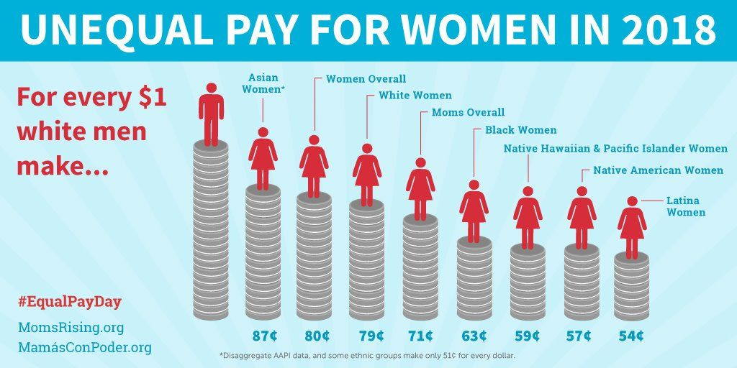
Different races
Women of race and color also deal with the unequal treatment of wages being earned.
African American women were making 0.62
Latin women were making 0.54
American Indian and Alaska Native were making 0.57
Hawaiian and pacific Islander make 0.61
All these women of different race were making this much compared to every dollar a Caucasian male works.

Slide 4
The history of unequal pay
The history of unequal pay began in the late 19th century.
Women began working when the men were deployed for the WW1 , except women were being paid less to do the same job the men were doing.
The first strike for equal pay for woman began in 1918.
A campaign began called the Equal Pay Act (1970) and this helped for men and women be entitled to the same amount of pay.
The Equal Pay Campaign had been passed in 1970 but was not able to be implemented into the laws until later on in January in 1976.

Slide 5
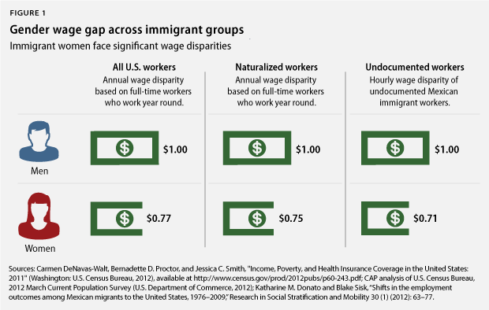
Women earn less the men
In 2018 women were earning 81.6 cents less then men for every dollar that they earned, with women also earning a 9,766 less compared to men.
In 2019 women were making 79 cents for every dollar men were making.
In 2020 women were earning 81 cents for every dollar men were making.

Slide 6

United Nations Population Funds
The United Nations Population Funds (UNFPA) provides family planning and reproductive services to more than 150 countries globally.
UNFPA works to expand contraception to women around the world. Helping combat maternal mortality, female genital mutilation, and HIV/AIDS.
Within the first 100 days in office President Trump’s administration has taken funding from the UNFPA. Funding had been blocked for 3 years straight, from 2017-2019.
The administration refused to provide funding under the Kemp-Kasten Amendment, which block U.S. aid to any organization the U.S. president determines is involved in coercive abortion or involuntary sterilization.
No evidence shows UNFPA supports coercive abortion or involuntary sterilization. UNFPA does not promote abortion in its family planning services or provide abortion services.
Funding from the U.S. in 2016 helped UNFPA provide contraception to 800,000 women and prevent 100,000 unsafe abortions worldwide.

Slide 7

Less Funding for Title IX in Colleges & Universities
Title IX (1972) is a federal (national) law that serves as a powerful tool for combating campus violence.
Under the Title IX it is stated that no person in the United States shall, on the basis of sex, be excluded from participation in, be denied the benefits, or be subjected to discrimination under any education program or activity receiving federal financial.
Colleges and universities receive funding to combat gender-based violence and harassment. They respond to victims/ survivors needs in order to ensure that all students have equal access to education.
Under the Trump Administration the new rules is making it harder for survivors to understand their legal rights.
The new rules have drastically limited the types of sexual misconduct universities are required to investigate.
The Trump Administration has reduced the number of cases universities can consider .
It is unclear if online students would be counted under Title IX considering they are off-campus.
Cases can be made on-campus, dorms, and or the Sorority housing, however it is up to the Universities if cases are made off-campus.
The New Title IX rules has given colleges and universities the power to choose when survivors are heard and when they are not.

Slide 8

Free The Nipple Movement
A campaign against the sexual objectification of women as well as equal rights as men.
If men can walk around topless so can women.
The 14th Amendment reads “No State shall make or enforce any law which shall abridge the privileges or immunities of citizens of the United States; nor shall any State deprive any person of life, liberty, or property, without due process of law; nor deny to any person within its jurisdiction the equal protection of the laws.”
The supreme court decided to leave the ruling the same for 3 women in New Hampshire, who decided to walk around topless. The women found this unjust that they were given a fine by doing what men have been doing since the 1930’s, walking around without a shirt.
Multiple celebrities have supported this movement including Miley Cyrus, Rihanna, Kendall Jenner, and Amber Heard.
Out of 50 states 2 are left with strict laws that do not allow women to show their breast in public, Tennessee and Indiana. 14 states with some ambiguous laws on the matter.

Slide 9

Title X Family Planning
Under the Trump Administration Federal funds will no longer be provided to family planning providers that offer abortion services.
The domestic gag-rule prohibits providers that receive Title X funding from referring patients for abortion services, providing information, or counseling related to abortion.
Title X clinics are no longer legally required to provide counselling that includes information about prenatal care, delivery, adoption, and abortion.

Slide 10
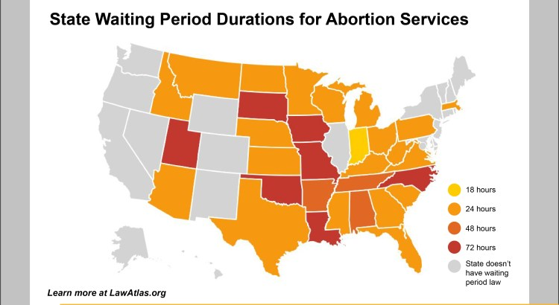
Abortion Laws
Since 2011, state legislature have passed more than 400 laws to restrict abortion.
States like Louisiana have insurance policies requiring a waiting period.
In 2020, Florida passed a bill requiring minors to have a written consent or that the minor receives a judicial pass to have an abortion.
Oklahoma enacted TRAP law that allows the parent of the fetus or the parent of a pregnant person to sue providers for wrongful death.

Slide 11
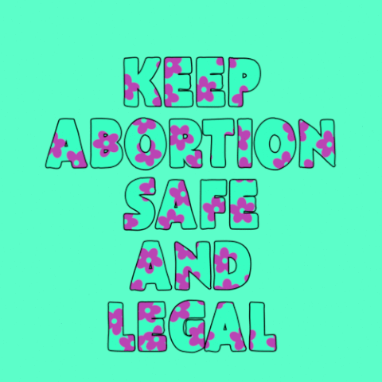
Restrictions in Florida
In 2017, 24% Women lived in counties that had less than 27% clinics that provide abortions.
The Affordable Care Act can only cover abortions in cases of life endangerment, rape or incest.
Women are forced to have ultrasounds and the provider is required to ask them if they want to see the image.
24 weeks or more abortions are only allowed in cases where there is life or health endangerment.

Slide 12
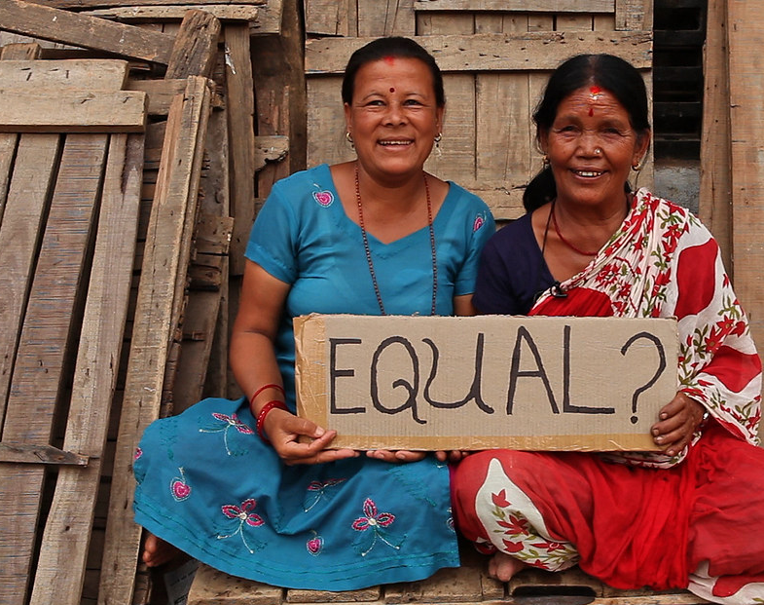
Woman in third world countries
Although no country has achieved total gender equality some places are pretty close while Others are miles away from it. Around the world, women are not given the same educational and occupational opportunities. They are denied a say in how they are governed, not able to participate fully in society and fear violence based on gender, violence against women, child marriage and educational attainment.
This Photo by Unknown Author is licensed under CC BY-NC-ND
Notes:
Slide by kameliah style

Slide 13
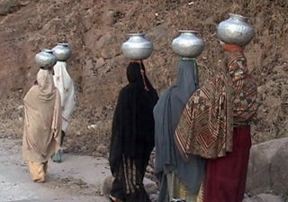
Where is being a woman the most difficult ?
  Yamen- Yemeni women cannot marry or receive health care without the permission of their male guardian . They do not have equal rights to divorce or child custody. Around 52% of girls in Yemen are married before the age of 18; there is currently no legal minimum of marriage age.
Honduras – on average one women is murdered every 18 hours and most of the murderers are getting away with it. The lack of accountability and prosecution of perpetrators of violence against women mean that women cant live safe.
This Photo by Unknown Author is licensed under CC BY-SA-NC
Notes:
Slide by kameliah style

Slide 14
Egypt – ranked as having one of the largest gender gaps on the World Economic forum’s 2015 Gender Gap report. More than 125 million Egyptian girls are believed to have endured the process of genital mutilation. Egypt's law tend to discriminate against women with regards to marriage , divorce , custody of children , and inheritance . There are no laws that criminalize domestic violence and protect women in their homes.
Saudi Arabia – like Yemen, Saudi women are forced to rely on male guardians. Without the permission of a male guardian these woman cant do many things that first world woman such as myself can do. women are also banned from driving.
This Photo by Unknown Author is licensed under CC BY-SA-NC
Notes:
Slide by kameliah style

Slide 15

Restriction on women rights around the world
No doesn’t mean no in north Carolina. it is not considered rape if a woman withdraws her consent once sex is underway.
Rapist can claim parental rights in seven states such as Maryland ,Wyoming and New Mexico
Women in Saudi Arabia can’t drive
A nigeran husband is permitted to hit his wife, under section 55 of the penal code, for the purposes of correcting her
Notes:
Slide by kameliah style

Slide 16
The Inequalities Women Face Around The World
Women are legally required to obey their husbands in 18 different countries
Women are restricted from choosing where they want to live in 31 different countries
Unlike men, night work hours are restricted for women in 19 different countries
Women cannot work in the same industries as men in 70 different countries
When it comes to marital rape, there is 111 countries that don't have a law against it
When women get pregnant after a certain amount of weeks during their pregnancy they need time off work to rest and care for the baby. There are 37 countries around the world that do not allow time off for pregnant workers
Sexual harassment in the workplace is a common and big problem for women. In 110 different countries, there is no criminal penalty for this.

Slide 17
More Inequalities
Specific tax deductions in tax credits are only available to men in 15 different countries
In 10 different countries, the mandatory retirement age is different for men and women
In 56 different countries, women cannot work in jobs labeled as hazardous or inappropriate
In 39 different countries, daughters are not allowed to have the same rights as sons to inherit assets from their parents
The government does not provide childcare services in 45 different countries
Domestic violence is not legally prohibited in 45 different countries

Slide 18
Work Cited
“The 14th Amendment of the U.S. Constitution.” National Constitution Center – The 14th Amendment of the U.S. Constitution, constitutioncenter.org/interactive-constitution/amendment/amendment-xiv.
Bedera, Nicole. “Trump's New Rule Governing College Sex Assault Is Nearly Impossible for Survivors to Use. That's the Point.” Time, Time, 14 May 2020, time.com/5836774/trump-new-title-ix-rules/.
Begley, Sarah. “Sunbathing Topless: A Map of Varying Laws.” Time, Time, 24 Apr. 2015, time.com/3834365/map-topless-laws/.
Gersen, Jeannie Suk. “How Concerning Are the Trump Administration's New Title IX Regulations?” The New Yorker, 2020, www.newyorker.com/news/our-columnists/how-concerning-are-the-trump-administrations-new-title-ix-regulations.
Hurley, Lawrence. “U.S. Supreme Court Refuses to 'Free the Nipple' in Topless Women Case.” Reuters, Thomson Reuters, 13 Jan. 2020, www.reuters.com/article/us-usa-court-topless/u-s-supreme-court-refuses-to-free-the-nipple-in-topless-women-case-idUSKBN1ZC1HQ.
Irm. “Topless Laws.” GoTopless, gotopless.org/topless-laws.
Osub Ahmed, Shilpa Phadke. “Women Have Paid the Price for Trump's Regulatory Agenda.” Center for American Progress, 2020, www.americanprogress.org/issues/women/reports/2020/09/10/490241/women-paid-price-trumps-regulatory-agenda/.
Rani, Rikha Sharma. “Trump's War on the Concept of Women's Health.” Foreign Policy, 10 Mar. 2020, foreignpolicy.com/2020/03/10/trump-war-concept-women-health-sexual-reproductive-rights/.
Simao, Karen. “10 Celebrities Who Support The Free the Nipple Movement.” TheRichest, 1 Jan. 2020, www.therichest.com/lifestyles/free-the-nipple-celebrity-support/.
Vogt, Bailey. “Federal Ruling Allows Women to Legally Go Topless in Six States.” The Washington Times, The Washington Times, 20 Sept. 2019, www.washingtontimes.com/news/2019/sep/20/federal-ruling-allows-women-to-legally-go-topless-/.
“What Is Title IX?” Ventura College, www.venturacollege.edu/college-information/about-ventura-college/title-ix/what-is-title-ix.
Zollner, Danielle. “Five Major Things Trump Has Done to Roll Back Women's Rights.” The Independent, Independent Digital News and Media, 6 Mar. 2020, www.independent.co.uk/news/world/americas/us-politics/trump-women-international-womens-day-abortion-policies-healthcare-a9380411.html.
Ellmann, N. (n.d.). State Actions Undermining Abortion Rights in 2020. Retrieved November 13, 2020, from https://www.americanprogress.org/issues/women/reports/2020/08/27/489786/state-actions-undermining-abortion-rights-2020/
Nash, E., & Guttmacher Institute. (2020, July 06). State Abortion Policy Landscape: From Hostile to Supportive. Retrieved November 13, 2020, from https://www.guttmacher.org/article/2019/08/state-abortion-policy-landscape-hostile-supportive
State Facts About Abortion: Florida. (2020, September 10). Retrieved November 13, 2020, from https://www.guttmacher.org/fact-sheet/state-facts-about-abortion-florida
Temple University Center for Public Health Law Research. (2019, January 18). Abortion Laws in America: 16 New Datasets Explore U.S. Legal Landscape. Retrieved November 13, 2020, from https://blog.petrieflom.law.harvard.edu/2019/01/18/abortion-laws-in-america-16-new-datasets-explore-u-s-legal-landscape/
Women's Workplace Equality Index: Leveling the Playing Field. (2018). Retrieved November 16, 2020, from https://www.cfr.org/legal-barriers/
Braybon, G.(1989)Women workers in the first World War. London: Routledge.
Anitha, S. and Pearson, R. (2014) Striking Women – striking out. Feminist Review 108: 61-70.
McDowell, L., Anitha, S. and Pearson, R. 'Striking narratives: class, gender and ethnicity in the Great Grunwick Strike of 1976-1978', Women's History Review.

